Slide 1



Slide 2
What Are The Drivers and Outcomes of A Country’s Happiness?
Arghavan Abtahi - Mariana Brinkley - Rafael Santos
Shayan Beizaee - Sandra Pastrana

Slide 3

Agenda
World Happiness Analysis
How happy is the world?
Weather vs. happiness.
Tourism vs. happiness.
Athletics vs. happiness.
Socio-economic indicators vs. happiness.
Musical choices vs happiness.
Discussion.

Slide 4
How Happy is the world?
World Happiness Analysis
Data: World Happiness Report: http://worldhappiness.report/ed/2018/
“Increasingly, happiness is considered to be the proper measure of social progress and the goal of public policy.”
World happiness | Weather | Tourism | Athletics | Economy | Music

Slide 5
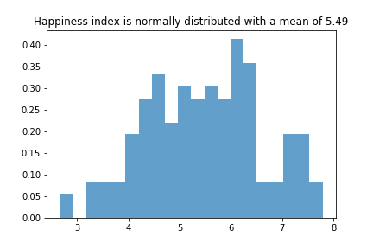
Exploration & Analysis – Happiness Index
World Happiness Analysis
World happiness | Weather | Tourism | Athletics | Economy | Music

Slide 6
2. Happiness vs. weather
World Happiness Analysis
Hypothesis:
The warmer the weather, the happier the country.
Data:
Open Weather API
World happiness | Weather | Tourism | Athletics | Economy | Music

Slide 7
Exploration & Analysis – Weather
World Happiness Analysis
Question
Does weather influence the happiness of a country?
Cleaning up data
collected data from the world happiness index and OpenWeatherMap
looped through the weather API to pull average temperatures
eliminated unnecessary columns and Nans from each data set
Merged the 2 data sets to form a clean dataframe
Graphing the results
scatter plot: showing the correlation between weather and happiness
Weather: independent, Happiness: dependent
regression line: showing a clearer comparison of the two
World happiness | Weather | Tourism | Athletics | Economy | Music

Slide 8
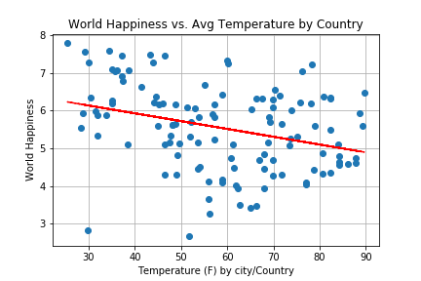
World Happiness Analysis
R squared = 0.09967
P-value = 0.00047
World happiness | Weather | Tourism | Athletics | Economy | Music

Slide 9
World Happiness Analysis
3. Tourism vs. happiness
Hypothesis:
Happier countries attract more tourism
Data:
International tourism, number of arrivals
https://data.worldbank.org
World happiness | Weather | Tourism | Athletics | Economy | Music

Slide 10
Exploration & Analysis – Tourism
World Happiness Analysis
Question
Do countries that are happier have more tourists?
Cleaning up data
Getting data from 2 different data sets
Removing irrelevant columns
Merging the 2 data sets and renaming the columns
Making a scatter plot
Correlation between happiness and tourism
Happiness: independent, # of tourists: dependent
Drawing regression line
To better analyze the correlation between happiness and tourism
World happiness | Weather | Tourism | Athletics | Economy | Music

Slide 11
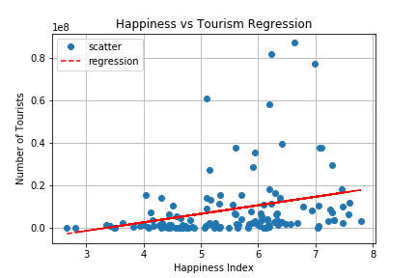
World Happiness Analysis
r-squared: 0.082 p-value: 0.00112
World happiness | Weather | Tourism | Athletics | Economy | Music

Slide 12
World Happiness Analysis
4. Athletics vs. happiness
Hypothesis:
Happier countries will have more olympic athletes
Data:
120 years of Olympic history: athletes and results
https://www.kaggle.com
World happiness | Weather | Tourism | Athletics | Economy | Music

Slide 13
Exploration & Analysis - Olympic Athletes
World Happiness Analysis
Question:
Is there a relationship between a country’s happiness and they number of athletes they send to the Olympics?
What other factors that contribute to a country's happiness also contribute to the number of Olympic athletes they have. (Ex: Social Support, Freedom to make life choices)
World happiness | Weather | Tourism | Athletics | Economy | Music

Slide 14
Exploration & Analysis - Olympic Athletes
World Happiness Analysis
Gathering Data and Clean Up:
Data:
World Happiness Report
Kaggle: 120 years of Olympic history: athletes and results
Clean Up:
Downloaded CSV files
Cleaned up column and narrowed data frame to a specific year
renamed columns and some rows to merge
World happiness | Weather | Tourism | Athletics | Economy | Music

Slide 15
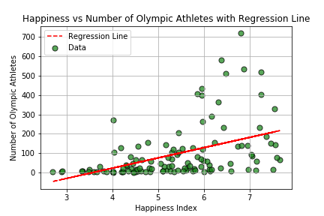
Exploration & Analysis - Olympic Athletes
World Happiness Analysis
Results:
R-Squared:
0.20293393269
P-Value:
2.7373772e-07
World happiness | Weather | Tourism | Athletics | Economy | Music

Slide 16
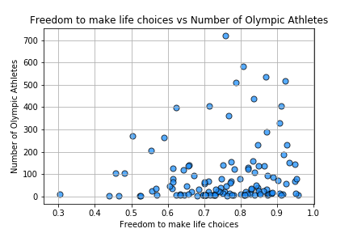
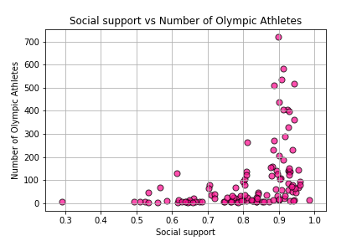
Exploration & Analysis - Olympic Athletes
World Happiness Analysis
Results:
World happiness | Weather | Tourism | Athletics | Economy | Music

Slide 17
World Happiness Analysis
5. Socio-economic indicators vs. happiness.
Question:
How socio-economic indicators influence happiness levels?
Hypothesis:
Countries with higher GDP, social support and individual income will have a higher happiness index.
Countries with lower unemployment rates will have a higher happiness index
Countries with higher technology penetration will have higher happiness index
World happiness | Weather | Tourism | Athletics | Economy | Music

Slide 18
World Happiness Analysis
5. Socio-economic indicators vs. happiness.
Data sources:
World Happiness Report: http://worldhappiness.report/ed/2018/
The world bank indicators API http://api.worldbank.org
Data loading and clean-up:
Adjust API calls to handle data failed requests (missing country/indicator on the end-point database)
Adjust methods to read indicators collected via API calls with different JSON data structures (diverse mix of nested combinations of dictionaries and lists)
Merge and clean up data sets with Non-values.
World happiness | Weather | Tourism | Athletics | Economy | Music

Slide 19
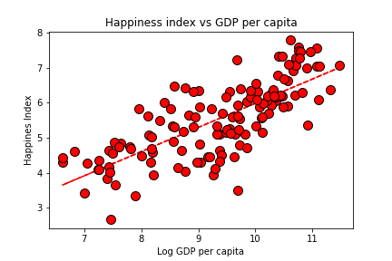
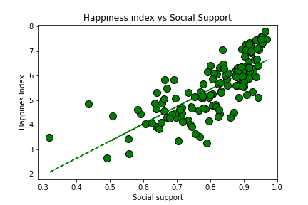
Exploration & Analysis – Socio-economic indicators
World Happiness Analysis
R- sqr= 0.56 P=value= 1.09e-25
R- sqr= 0.56 P=value= 2.67e-27
based on: World Happiness Report
World happiness | Weather | Tourism | Athletics | Economy | Music

Slide 20
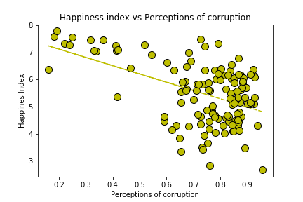
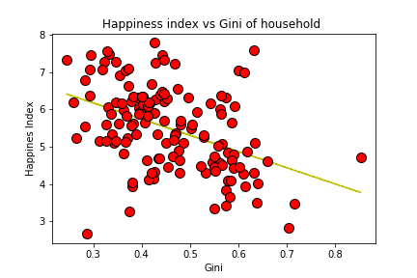
Exploration & Analysis – Socio-economic indicators
World Happiness Analysis
R- sqr= 0.17 P=value= 1.32e-25
R- sqr= 0.23 P=value= 4.28e-9
based on: World Happiness Report
World happiness | Weather | Tourism | Athletics | Economy | Music

Slide 21
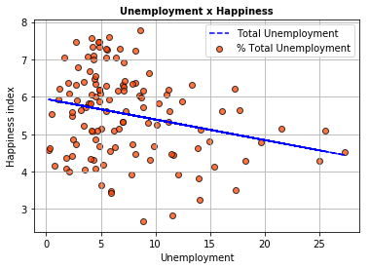
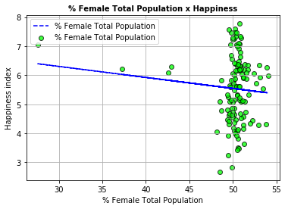
Exploration & Analysis – Social-economic indicators
World Happiness Analysis
R- sqr= 0.06333865963 P-Value= 0.00463697589
R- sqr= 0.0082634 P-Value= 0.31335449
based on: World Bank indicators
World happiness | Weather | Tourism | Athletics | Economy | Music

Slide 22
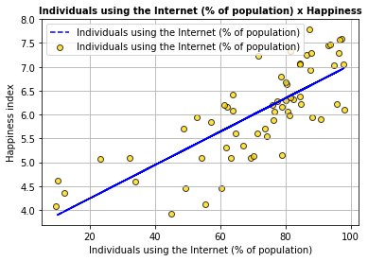
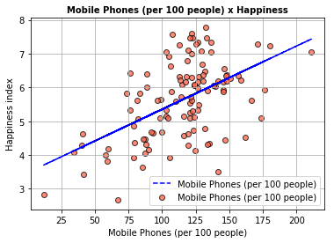
Exploration & Analysis – Social-economic indicators
World Happiness Analysis
R- sqr= 0.598479733 P-Value= 1.69500712
R- sqr= 0.277170615 P-Value= 2.108157688
based on: World Bank indicators
World happiness | Weather | Tourism | Athletics | Economy | Music

Slide 23
World Happiness Analysis
6. Musical preferences vs. happiness.
Hypothesis
People’s musical choices are driven by they happiness level.
happier people will choose to listen to happier music, more energetic music, more danceable music and music that is more wordy.
Data sources:
Spotify, Spotypy API
World happiness | Weather | Tourism | Athletics | Economy | Music

Slide 24
Exploration & Analysis – Musical expression
World Happiness Analysis
Three step process:
Collect the top songs for different countries.
Made a list of countries and dates to search for their top 200 songs. Chose to select one day a month for 66 countries that were available in SpotifyCharts
The Api does not allow for this, so we used some one else’s code. Installed a the code into PythonData
Saved the results into a cvs file
Classify each songs happiness, energy, danceability and speechiness.
Used the spotify API for python called Spotipy. Classified each song collected.
Compare against the World Happiness Index.
World happiness | Weather | Tourism | Athletics | Economy | Music

Slide 25
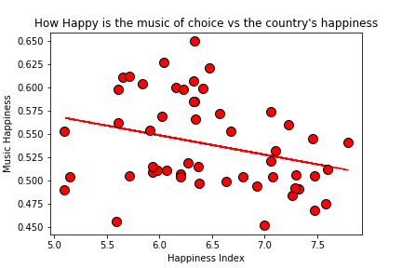
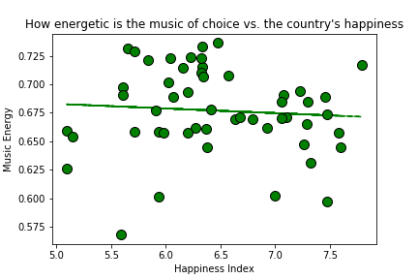
Exploration & Analysis – Musical expression
World Happiness Analysis
R- sqr= 0.084 P-Value= 0.034
R-sqr = 0.004 P-Value= 0.59
World happiness | Weather | Tourism | Athletics | Economy | Music

Slide 26
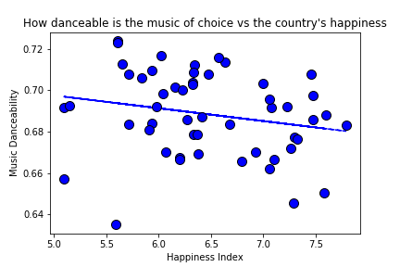
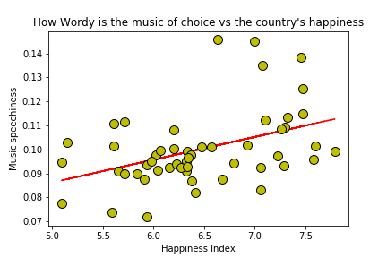
Exploration & Analysis – Musical expression
World Happiness Analysis
R-sqr = -0.041 P-Value= 0.13
R = 0.17 P-Value= 0.00183
World happiness | Weather | Tourism | Athletics | Economy | Music

Slide 27
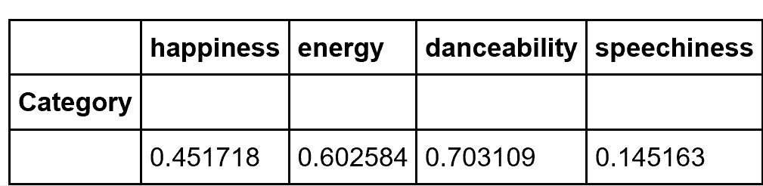
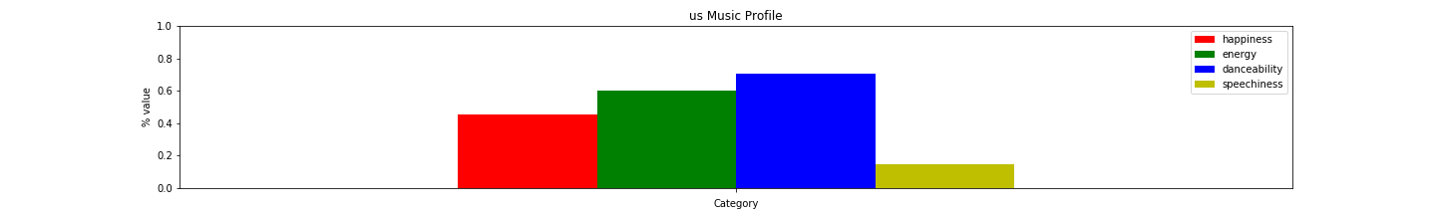
Exploration & Analysis – Musical expression
World Happiness Analysis
Side questions: What is the specific music profile of the US? Can we find a song with that specific profile?
Ahora Dice (feat. J Balvin & Arcangel)
https://www.youtube.com/watch?v=c73Cu3TQnlg
World happiness | Weather | Tourism | Athletics | Economy | Music

Slide 28
Conclusions
World Happiness Analysis
Drivers of happiness:
Weather: There is not a clear relationship between weather and happiness.
Socio-economic indicators that have more complex set of data forming the indicators tend to present more meaningful correlations:
countries that have higher GDP, social support, lower perceptions of corruption, and lower unemployment rates, tend to be happier.
gender majority, internet and mobile phone usage indicators did not provide strong or objective correlation.
Outcomes of happiness:
Tourism: happier countries have more tourism.
Athletics:happier countries produce more olympic athletes.
Music: There is not a clear relationship between happiness and the kind of music people choose and prefer to listen to.

Slide 29
Discussion
World Happiness Analysis

Slide 30
Appendix
World Happiness Analysis

Slide 31
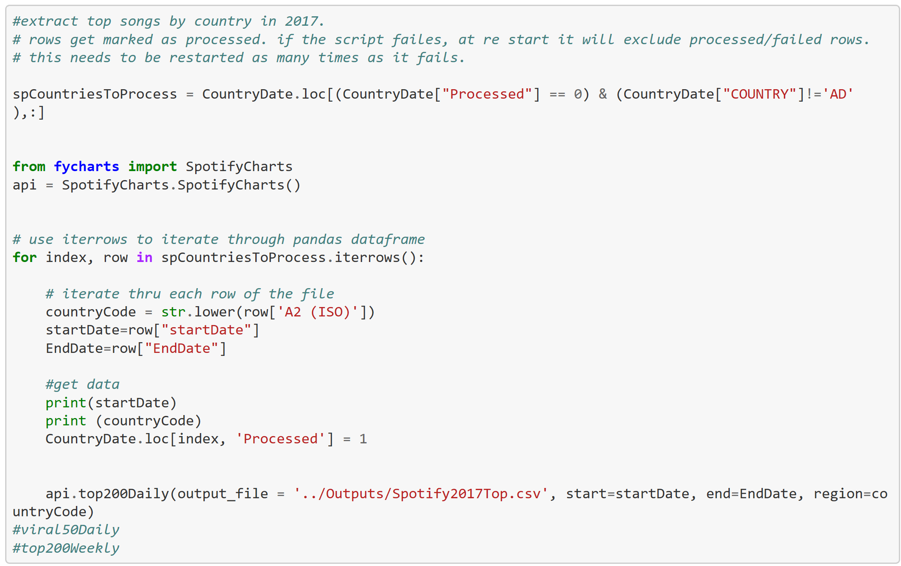
Spotify – Code to get top 200 songs
World Happiness Analysis
Looped through a Dataframe with a list of countries and a random day per month, for a total of 12 days per country.
Appendix

Slide 32
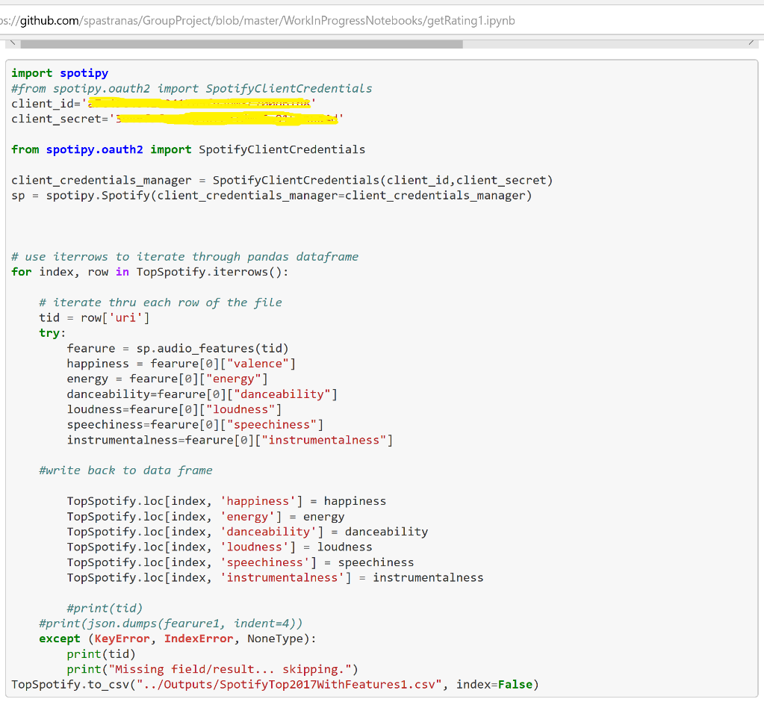
Spotify – Use Spotipy API to classify songs
World Happiness Analysis
Looped each song collected. Final count were 66 countries and 60,000 songs.
Appendix

